Slide 1
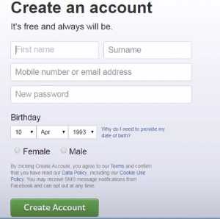
Create Account on FB

Slide 2

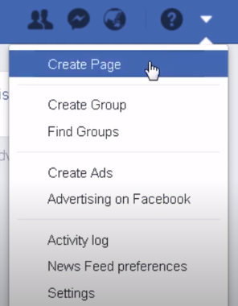
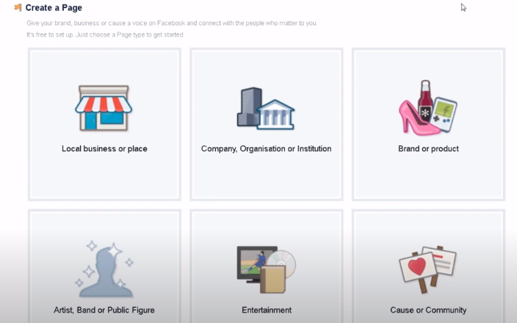
Create a FB page

Slide 3
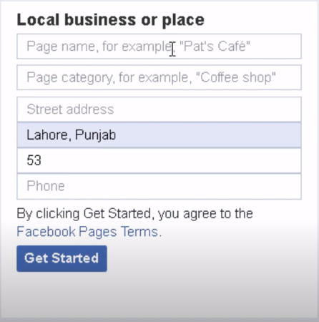
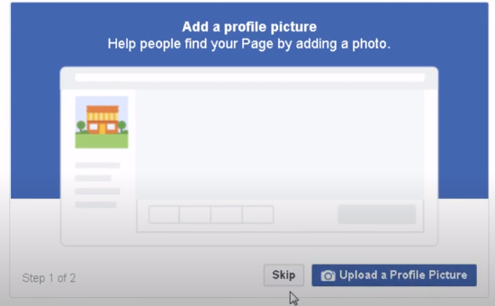
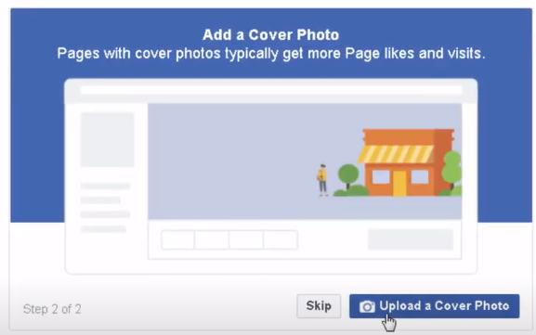
Create page

Slide 4
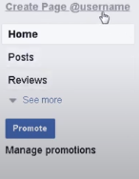
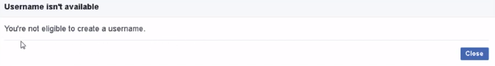
Add username

Slide 5
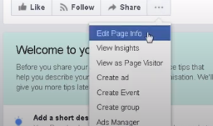
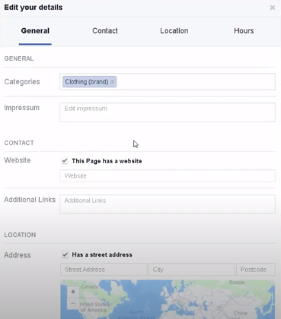
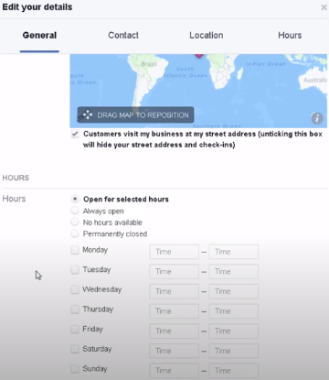
Setting

Slide 6
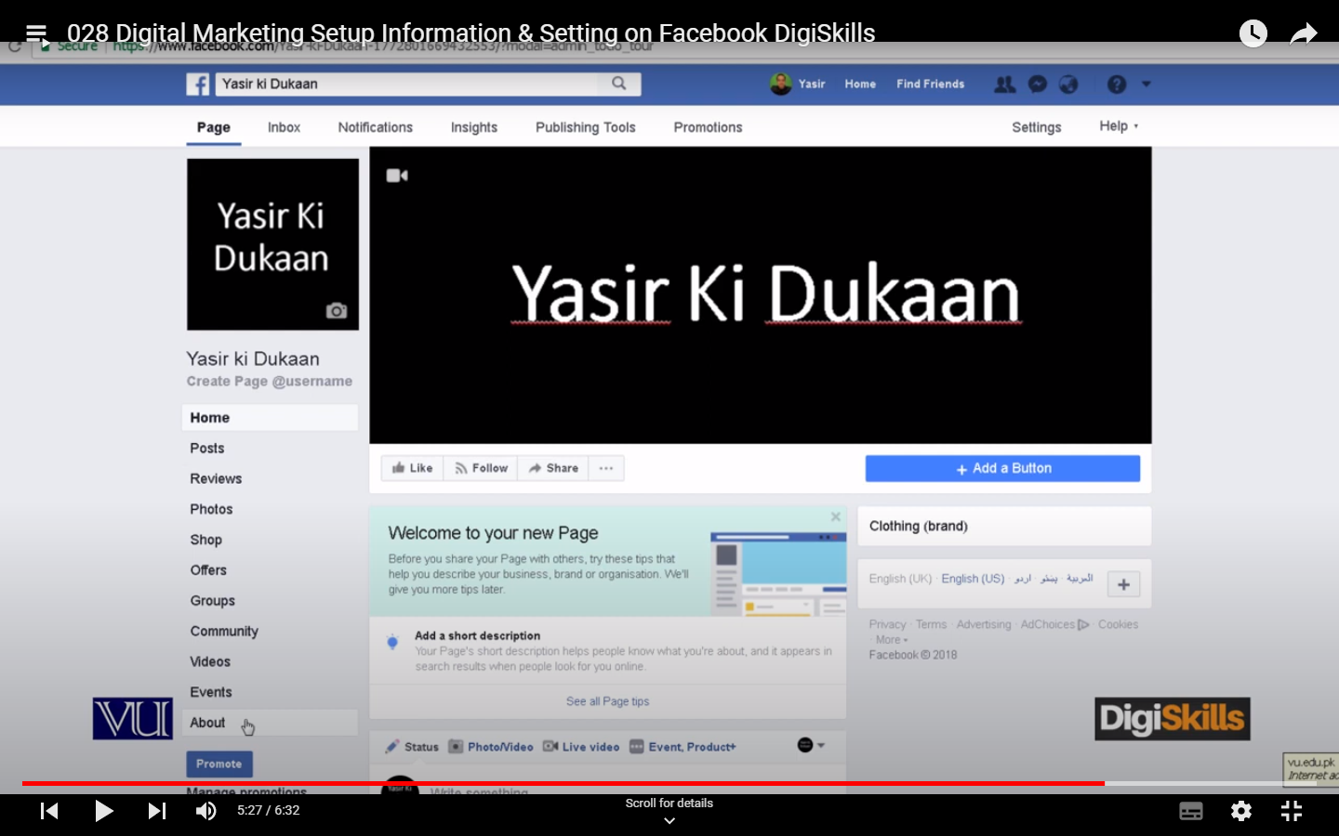
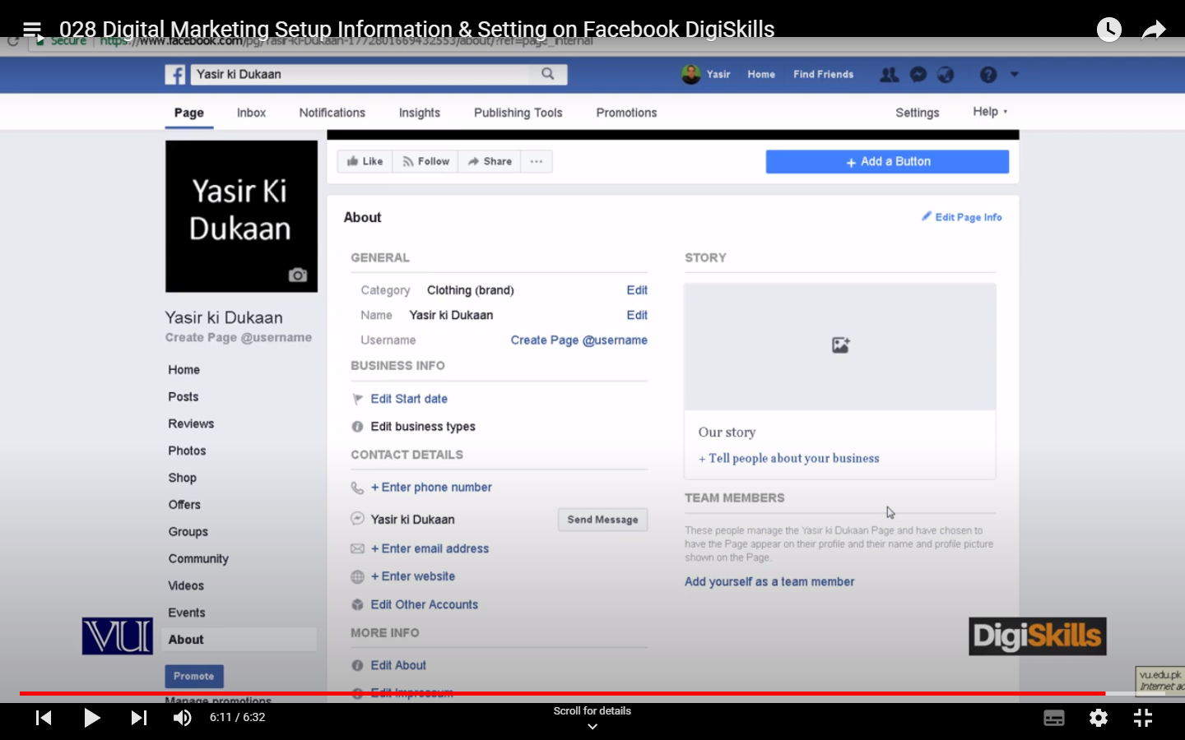

Slide 7
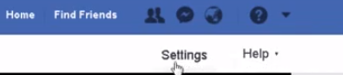
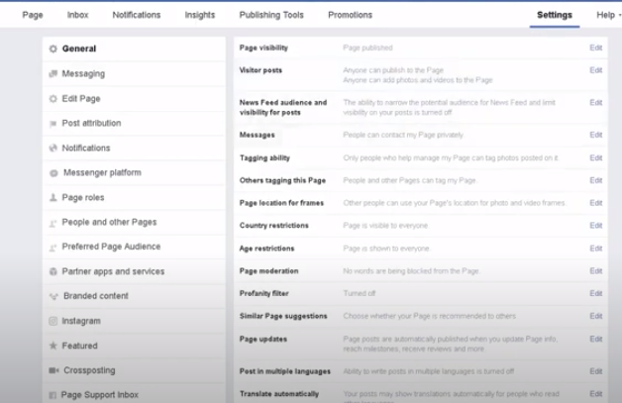
Advance Settings

Slide 8
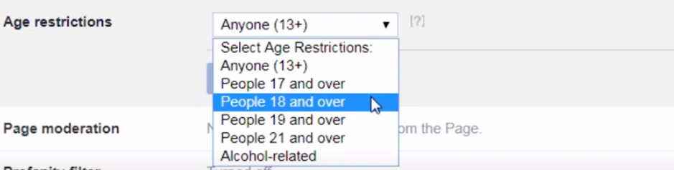
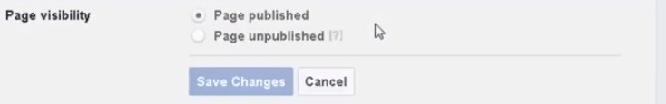
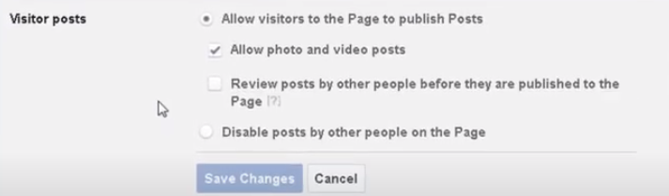
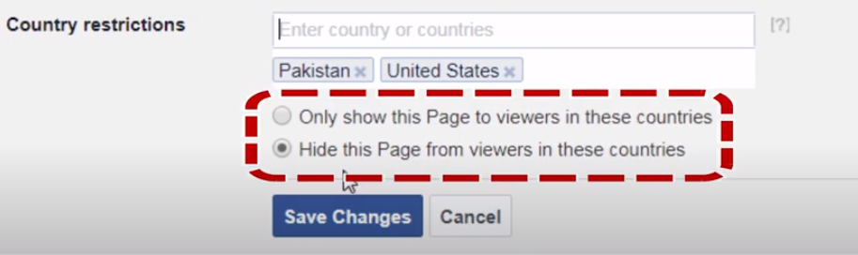
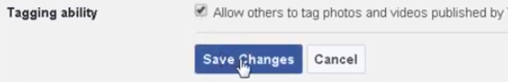

Slide 9
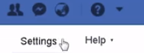
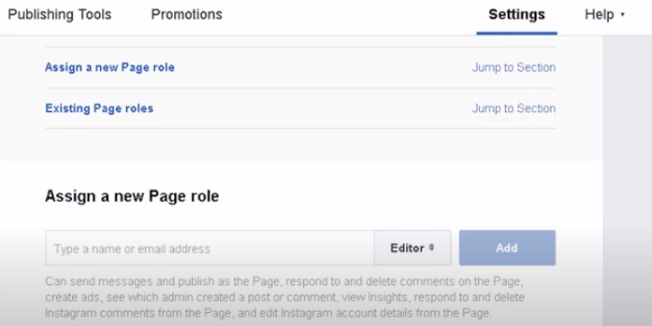
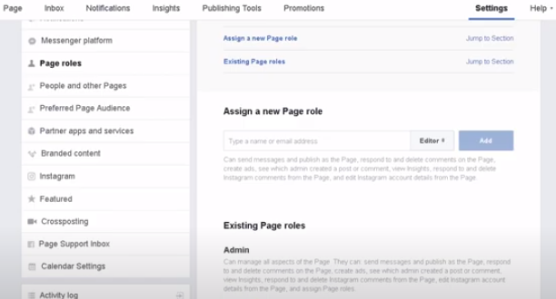
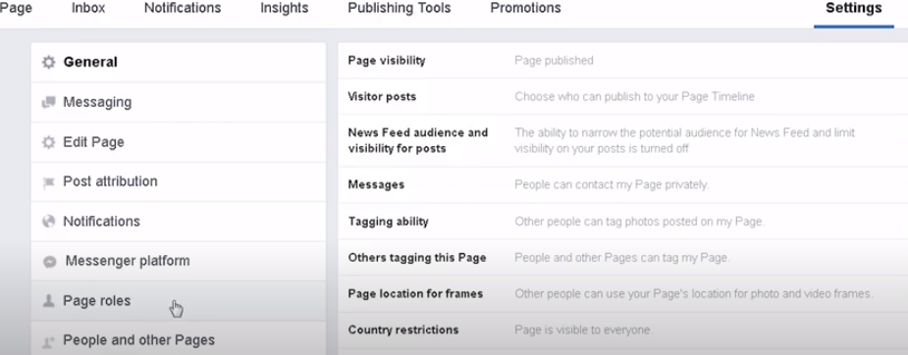
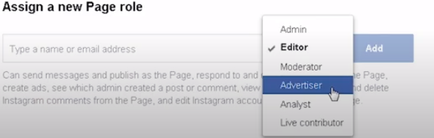
Assigning & Editing page Roles

Slide 10
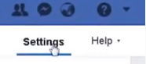
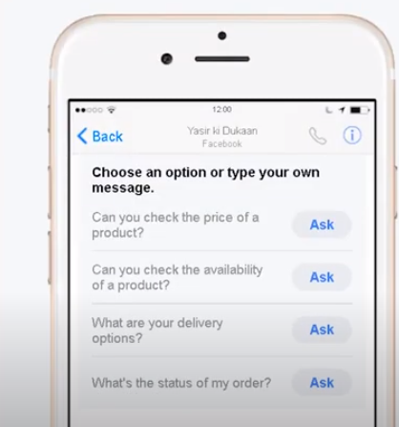
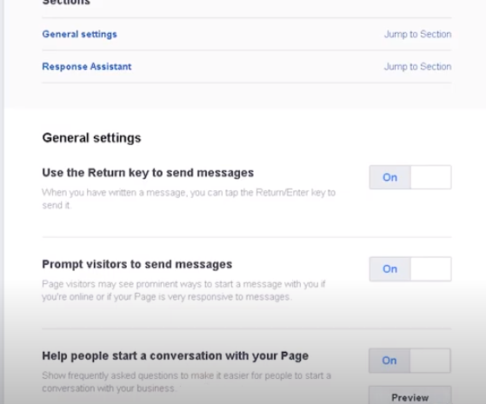
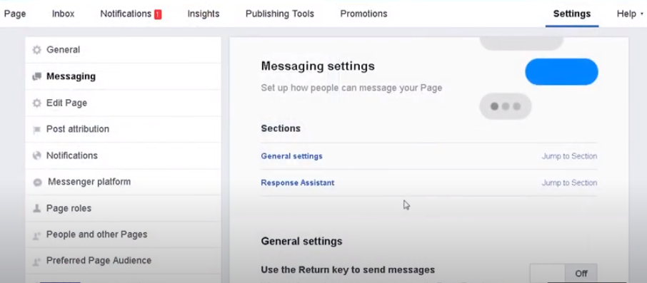
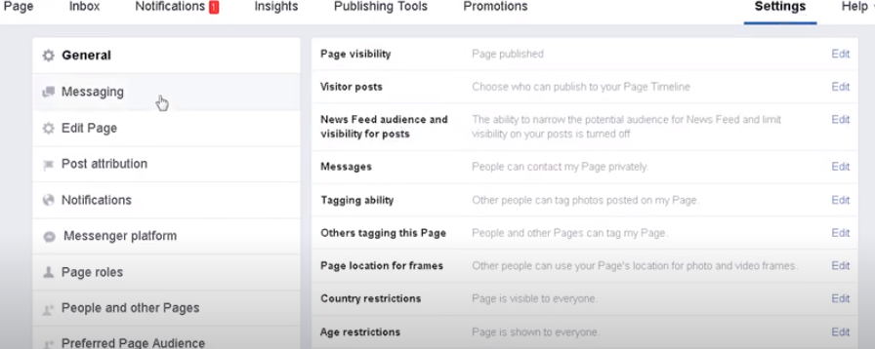
Robust and Professional Messaging

Slide 11
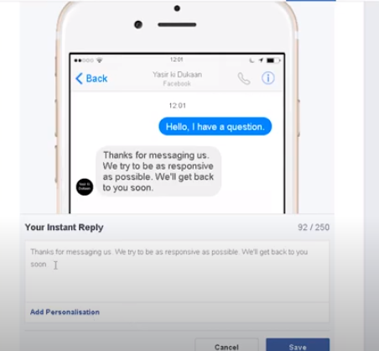
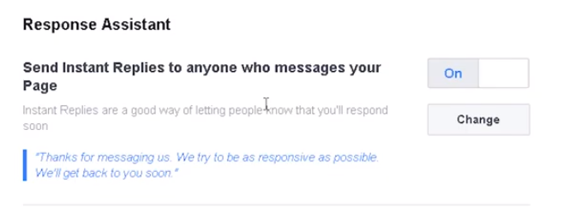
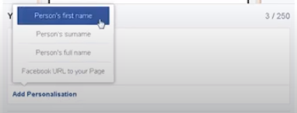

Slide 12
Organic Reach on Facebook
Reach
People who saw your post or page on news feed.
People who recommended you post or page is also part of reach.
Organic Reach
The no. of people who are reach by content of a page that is unpaid.

Slide 13

Organic/Natural vs Paid Reach

Slide 14
Paid reach
Fast(reach millions of user within a week)
Targeted(gender, age, location)
Measurable(Analytics of your paid reach)

Slide 15
Organic Reach Methods
Content Variety
Targeted Post
Posting time
Choose right images
Post videos
Use hashtags

Slide 16
Pros and Cons of Paid Reach
Pros
Reach lots of peoples
Targeted your market easily
Your ad is easily noticed
You save money(cheaper than TV ads)
Achieve multiple goals

Slide 17
Cons
Sponsor is shown on news feed
May not interested

Slide 18
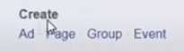
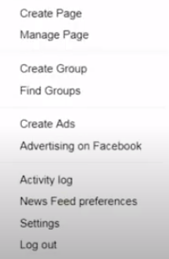

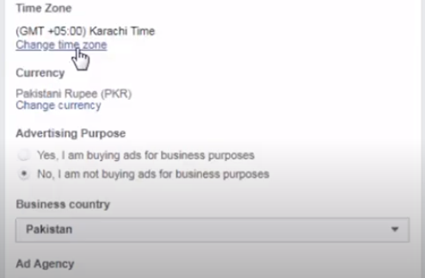
Adverts is used for running paid ads

Slide 19
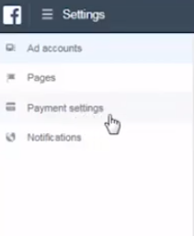
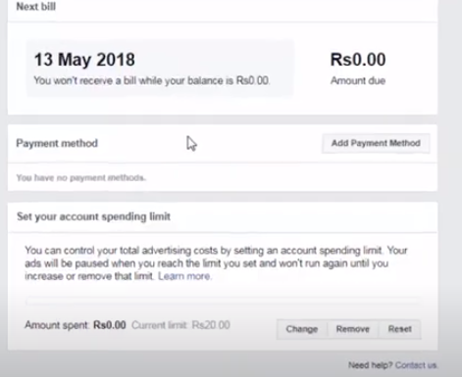
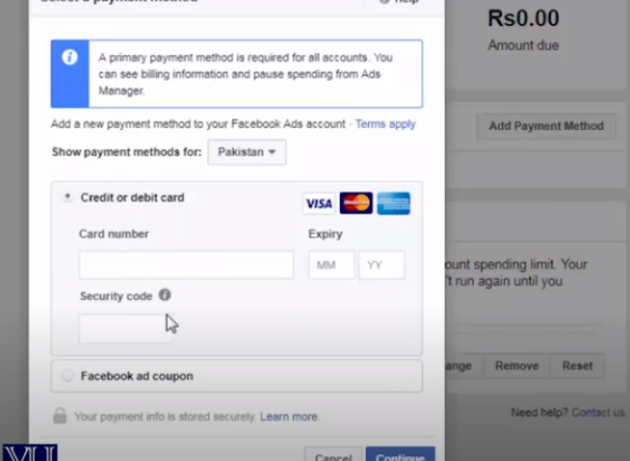

Slide 20
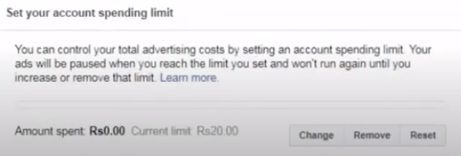
Spending Limit

Slide 21
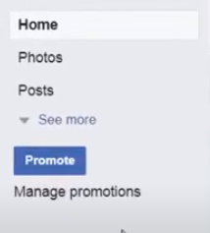
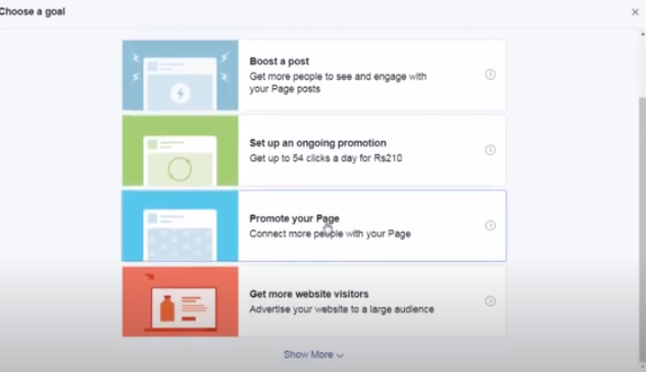
Page Promotion

Slide 22
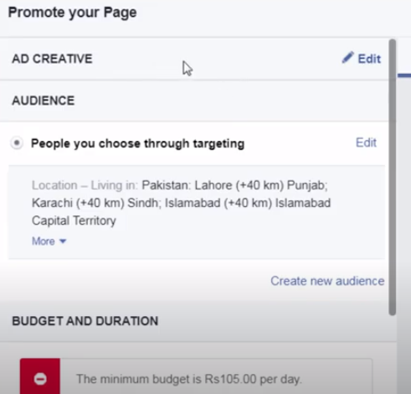

Slide 23
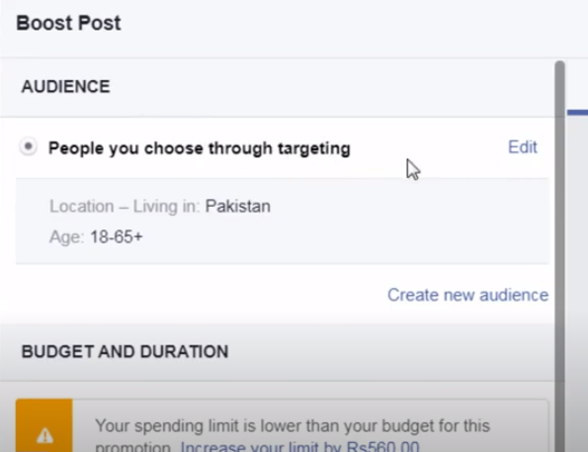
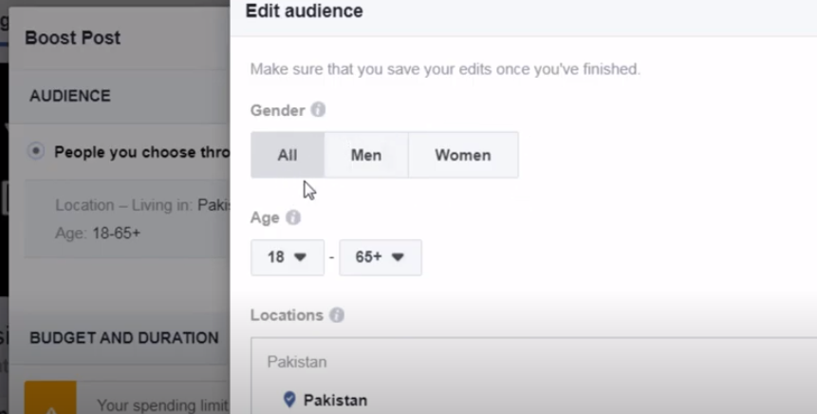
Boost post

Slide 24
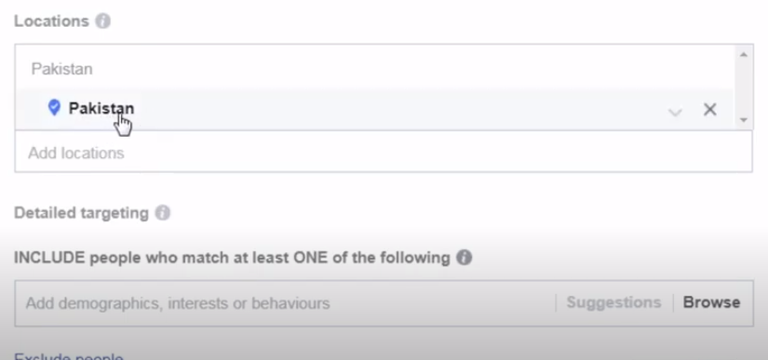

Slide 25
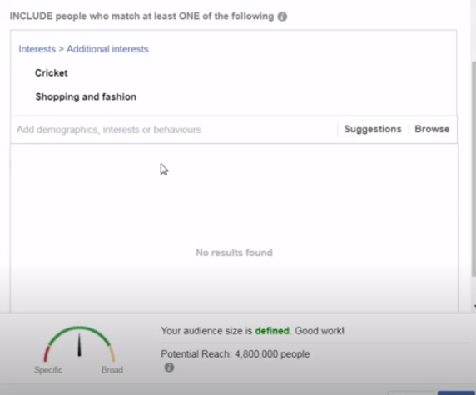
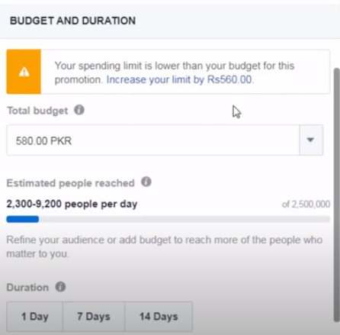

Slide 26
Edge Rank Algorithm
Affinity Score(friends mein se kisi ne like kara haai to news feed pe show krta haai)
Interest ko dekh k show krta hai. For e.g: (interest in shopping ka page like kara howa haai kisi ne to apka bhi page dikhayega agr who shopping k upper bna howa)
Interaction(same category) for e.g kisi entertainment k page k upper comment ya like kara to apka page bhi dikhayega agr uski category entertainment hoi.
Edge weight(no use of text) use photo or videos only for more reach.

